Slide 1
Death Certificates, Coroner Cases, and the Autopsy
Brian Nagao, M.D.
Forensic Pathologist
Hilo Medical Center Grand Rounds
May 18, 2023

Slide 2
Financial Disclosure
No relevant financial conflicts
Employee of Pan Pacific Pathologists (subcontractor for Clinical Labs of Hawaii, parent company Sonic Healthcare USA)
Per diem forensic pathologist with Honolulu Medical Examiner’s Office
Credit Statement
The AAFP has reviewed Grand Rounds, and deemed it acceptable for AAFP credit. Term of approval is from 01/27/2023 to 01/26/2024. Physicians should claim only the credit commensurate with the extent of their participation in the activity.
This session is approved for (1.0) in-person live AAFP Prescribed credits.
AAFP Prescribed credit is accepted by the American Medical Association as equivalent to AMA PRA Category 1 credit(s)™ toward the AMA Physician's Recognition Award. When applying for the AMA PRA, Prescribed credit earned must be reported as Prescribed, not as Category 1.

Slide 3
Overview
Importance of proper death certification
Death certificate
Cause of death; Other significant conditions
Death certification process
Cause-of-death statements
Death certificate errors
Coroner-Medical Examiner cases
Introduction to autopsy

Slide 4
Importance of Proper Death Certification
Provide closure to the next of kin (NOK)
Settle estates, pensions, and insurance benefits
Collect accurate national mortality data
Detect and track public health issues
Direct research and funding priorities

Slide 5
Death Certificate
State legal document, often issued by the local health agency:
  Standard information:
    Demographics
    Date, time, place, cause, and manner of death
    Certifier of death
    Coroner-Medical Examiner referral
    Performance of an autopsy
    Disposition of the body
  Additional information:
    Pronouncer of death
    Tobacco use contributing to death
    Recent pregnancy or surgery
Required for burial, cremation, and transportation permits

Slide 6
Death Certificate
Pronouncer of death:
  Individual who determined the death occurred
Certifier of death:
  Practitioner who lists the cause of death
Cause of death (COD):
  Injury or illness that leads directly to death
  Opinion, to the best of the practitioner’s knowledge, of what most likely caused death
  Does not require 100% certainty
  Can be listed as “Pending” by the Coroner or Medical Examiner (ME)
  Can be amended if new information becomes available

Slide 7
Death Certificate
“Cause of death” section - “Part I”
“Other significant conditions” section - “Part II”
Manner of death (MOD):
  Natural: caused entirely by natural disease
  Homicide: death at the hands of another person
  Suicide: deliberate self-harm
  Accident: injury or drug intoxication not homicidal or suicidal
  Undetermined: insufficient information to assign one of the above
Clinicians certify natural deaths
Coroners, forensic pathologists, and MEs certify unnatural deaths

Slide 8
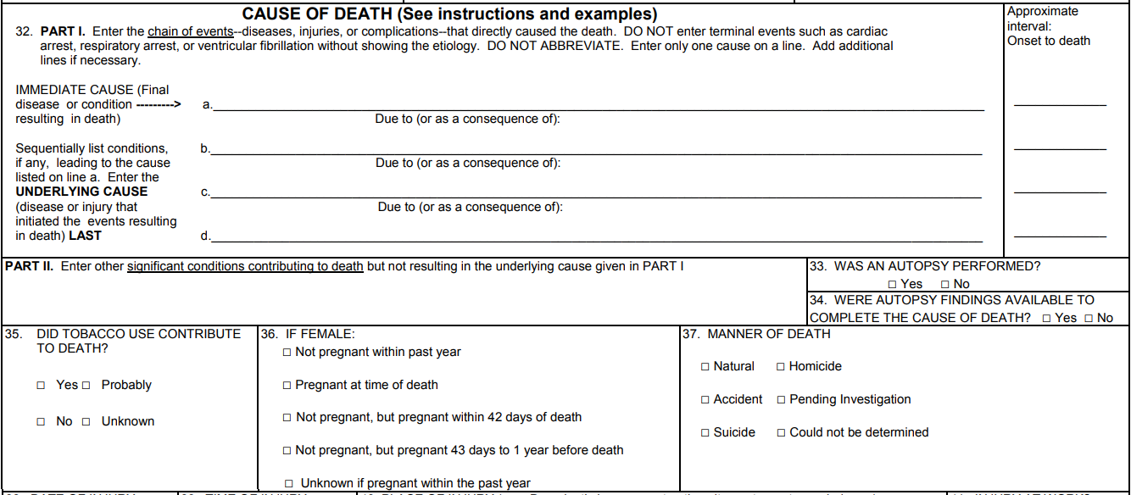
Death Certificate
Standard U.S. Death Certificate Template: CDC.gov

Slide 9
Cause of Death
Underlying COD (i.e. proximate COD):
  The initiating illness or injury that led to the sequence of disease processes that resulted in death
  Idiopathic or highly multifactorial in origin
  Examples: coronary atherosclerosis, essential hypertension, diabetes mellitus, autoimmune diseases, community-acquired infections, most malignancies
Immediate COD:
  Disease process that happened right before death
  Examples: septic shock, acute renal failure, uncal herniation
  Does not include terminal events: cardiac arrest, respiratory arrest
Intermediate COD:
  Disease process(es) resulting from the underlying COD, up to the point of the immediate COD

Slide 10

Other Significant Conditions (OSC)
Diseases that contributed to death
Did not initiate the lethal sequence
Examples:
  Emphysema in a patient who died of COVID
  Diabetes mellitus in a patient who died of diffuse large B-cell lymphoma

Slide 11
Death Certification Process
Hawaii:
  Hawaii Revised Statutes (HRS) Chapter 338: Vital Statistics¹
  Death certificates issued by the Hawaii Department of Health (DOH)
  Physician, PA, APRN, forensic pathologist, or ME completes the cause-of-death statement and medical information
  Fill out by hand and sign the Hawaii Death Certificate Worksheet
  Must be filed within 3 days
  Funeral home files the death certificate through EDRS
  DOH reviews the cause-of-death statement for compliance with ICD-10 and state guidelines
  Death certificates in compliance are formally registered
  Certificates with problematic cause-of-death statements are queried
1. https://www.capitol.hawaii.gov/hrscurrent/vol06_ch0321-0344/HRS0338/HRS_0338-.htm

Slide 12
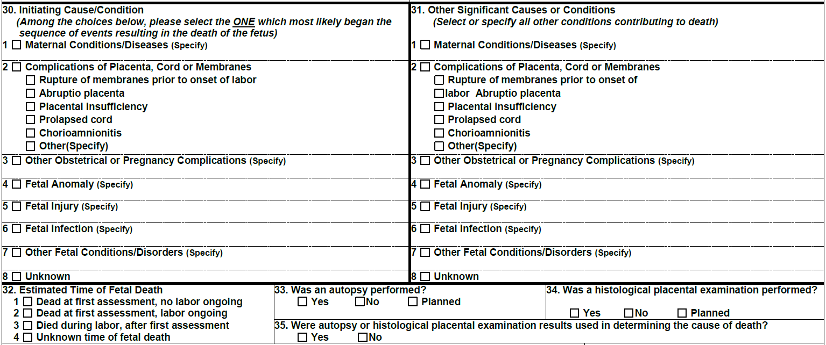
Death Certification Process
Fetal death: prior to complete expulsion/extraction from the mother
State laws specify when fetal death certificates are required
Generally required if over 350 grams or beyond 20 weeks of gestation
Hawaii: All products of conception (ITOP form or fetal death certificate)¹

Slide 13
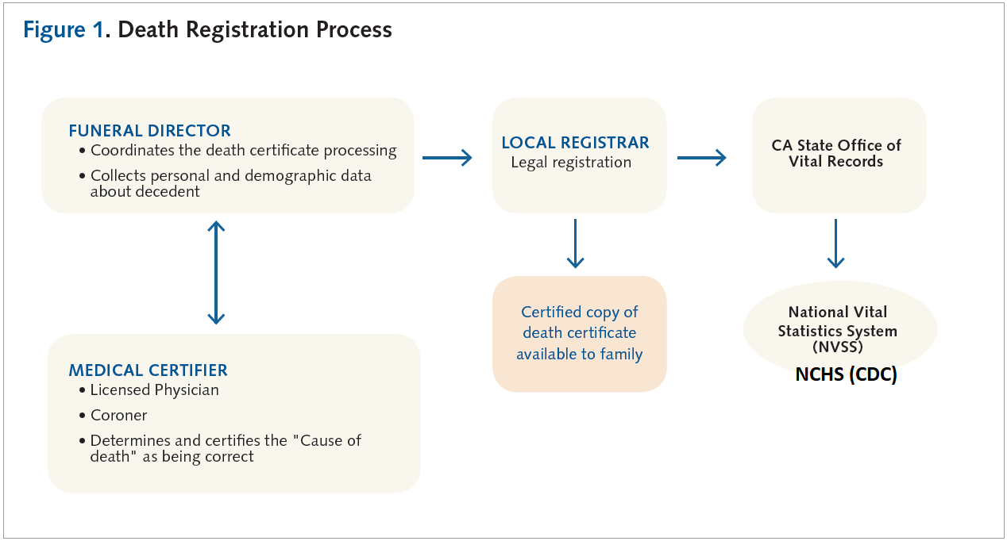
Death Certification Process
2. Sejbuk NE, Friedman E, Lieb L. Creating an Accurate Cause of Death Statement on a Death Certificate. Rx for Prevention. May 2014.

Slide 14
Death Certification Process
Cause-of-death statements that trigger a query:
  Statements indicating the death is unnatural:
    Trauma, intoxication, asphyxiation, neglect, or environmental exposure
  Statements that may indicate an unnatural death:
    Examples: drug use/abuse, decubitus ulcers, paraplegia, quadriplegia, seizure disorder, intracranial hemorrhage, complication of treatment
  Not listing a true underlying COD:
    Examples: pneumonia, aspiration, urinary tract infection, sepsis, shock, pulmonary emboli, organ failure, hypoxic-ischemic encephalopathy
  Listing a reportable disease

Slide 15
Cause-of-Death Statements
Immediate COD
X
Intermediate COD
X
Underlying COD
X
Line a – immediate COD and the time interval between its onset and death
Line b – intermediate COD and the time interval
Line c – underlying COD and the time interval
Time intervals – immediate, seconds, minutes, hours, days, weeks, months, years, or unknown

Slide 16
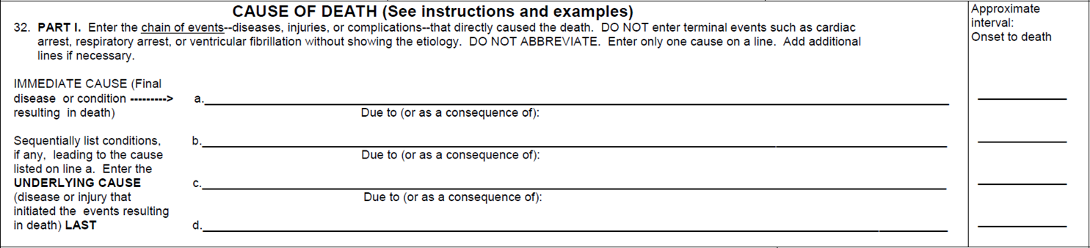
Cause-of-Death Statements
Urosepsis
Days
Pyelonephritis of the right kidney
Weeks
Obstructive uropathy
Months
Urothelial carcinoma of the bladder
Years
Follow a pathophysiologic and sequential order
List only one disease process per line
Include an acceptable underlying COD
Avoid abbreviations
Malignancies: specify cell type, organ, and location if known

Slide 17
Cause-of-Death Statements
“Probable” and “Likely” can be used to indicate some uncertainty:
  Example: poorly differentiated metastatic carcinoma of probable ovarian origin
“Uncertain” can be used to indicate greater uncertainty:
  Example: metastatic malignancy of uncertain origin
Immediate and intermediate CODs can be omitted:
  The underlying COD alone can be written in line a

Slide 18
Cause-of-Death Statements
Both acceptable
Gastrointestinal hemorrhage
Hours
Ruptured esophageal varices
Hours
Cirrhosis
Years
Autoimmune hepatitis
Years
Autoimmune hepatitis
Years

Slide 19
Cause-of-Death Statements
Not acceptable
No acceptable underlying cause of death is listed:
“Pneumonia” is not recognized as an underlying COD
Acute respiratory distress syndrome
Hours
Pneumonia
Days

Slide 20
Cause-of-Death Statements
Acceptable
Use of “Community-acquired” indicates that it is a de novo infection that did not result from another condition
Acute respiratory distress syndrome
Hours
Community-acquired pneumonia
Days

Slide 21
Cause-of-Death Statements
Acceptable
Aspiration pneumonia is a common, often unavoidable complication of many debilitating natural diseases
Must be distinguished from aspiration while unconscious from trauma or intoxication which represents and unnatural death
Must be distinguished from choking which is also unnatural
Acute respiratory distress syndrome
Hours
Aspiration pneumonia
Days
End-stage Alzheimer's Disease
Years

Slide 22
Cause-of-Death Statements
Acceptable
When listing “hospital-acquired pneumonia”, an acceptable underlying COD must also be listed
Acute respiratory distress syndrome
Hours
Hospital-acquired pneumonia
Days
Multiple myeloma
Years

Slide 23
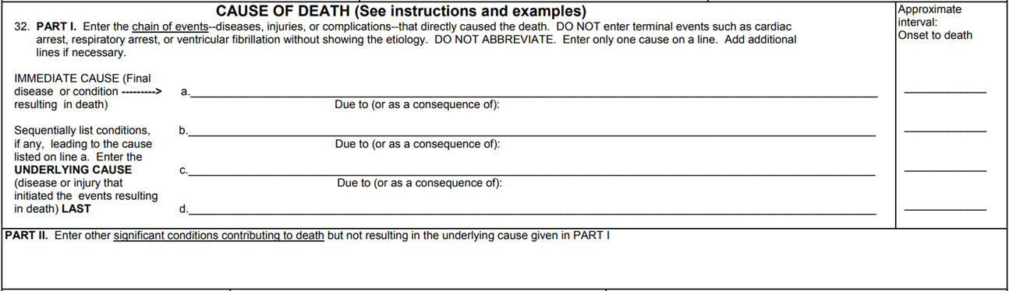
Cause-of-Death Statements - Case
A 61-year-old man with a history of diabetes, heavy cigarette smoking, COPD, back pain, and NSAID use presents with 1 day of fever, N/V, abdominal pain, and abdominal distention. A workup demonstrates a perforated gastric ulcer and peritonitis. He underdoes emergent laparotomy, resection of the gastric ulcer, peritoneal washout, and antibiotic therapy. The histopathology reveals a non-neoplastic ulcer in a background of gastritis with H. pylori. He develops sepsis and dies 3 days post op.

Slide 24
Cause-of-Death Statements - Case
A 61-year-old man with a history of diabetes, heavy cigarette smoking, COPD, back pain, and NSAID use presents with 1 day of fever, N/V, abdominal pain, and abdominal distention. A workup demonstrates a perforated gastric ulcer and peritonitis. He underdoes emergent laparotomy, resection of the gastric ulcer, peritoneal washout, and antibiotic therapy. The histopathology reveals a non-neoplastic ulcer in a background of gastritis with H. pylori. He develops sepsis and dies 3 days post op.
Sepsis
Days
Peritonitis
Days
Perforated gastric ulcer
Days
Peptic ulcer disease
Unknown

Slide 25
Death Certificate Errors
3. Alipour J, Payandeh A. Common errors in reporting cause-of-death statement on death certificates: A systematic review and meta-analysis. J Forensic Leg Med. 2021 Aug;82:102220.

Slide 26
Death Certificate Errors
Included 35 total studies
  7 – India
  5 – Iran
  3 – U.S., South Korea
  2 – Egypt, Ghana, Greece, South Africa
  1 – Palestine, Bangladesh, Nepal, China, Pakistan, Spain, Taiwan, Australia, Sweden
Categorized 13 types of errors
  Omitted time intervals – 80.9%
  Absent/inappropriate OSC – 45.1%
  Wrong underlying COD – 38.9%
  Improper sequence – 36.2%
  Mechanism of death included with underlying COD – 33.6%
  Abbreviation(s) used – 33.0%
  Mechanism of death only – 23.9%
  Competing causes of death – 21.5%
  More than 1 disease process per line - 19.3%

Slide 27
Death Certificate Errors
Studies that categorized errors agreed on gradings of major or minor:
  Omitted time intervals – minor error
  Absent/inappropriate OSC – minor error (majority)
  Wrong underlying COD – major error
  Improper sequence – major error
  Mechanism of death included – minor error
  Mechanism of death only – major error
  Competing causes of death – major error
  More than 1 disease process per line – minor error

Slide 28
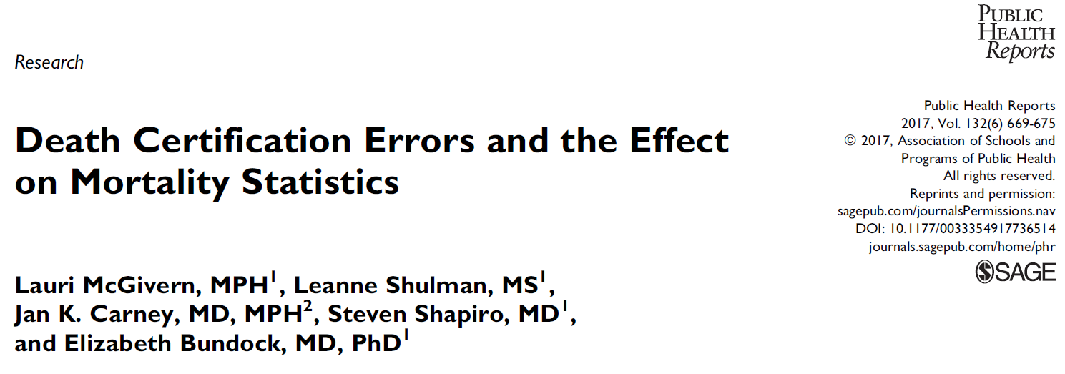
Death Certificate Errors
4. McGivern L, Shulman L, Carney JK, Shapiro S, Bundock E. Death Certification Errors and the Effect on Mortality Statistics. Public Health Rep. 2017;132(6):669–75.

Slide 29
Death Certificate Errors
Retrospective review of Vermont death certificates completed by non-MEs from July 1, 2015 to January 31, 2016
601 cases
Medical histories reviewed by two MEs blinded to original death certificates
Generated mock death certificates by consensus
Compared to original death certificates to identify errors

Slide 30
Death Certificate Errors
Errors graded:
  1 – Minor (limited impact on interpretation)
  2 – Minor (potential impact on interpretation)
  3 – Major (impact on interpretation of OSC)
  4 – Major (impact on interpretation of COD and MOD)
    Underlying COD listed in OSC
    No underlying COD
    Wrong underlying COD
    Underlying COD listed out of sequence
    Wrong MOD

Slide 31
Death Certificate Errors

Slide 32
Death Certificate Errors
Determined if ICD-10 codes including the underlying COD code changed between the original and mock death certificates:
  ICD-10 code change in 93% of cases
  Underlying COD code change in 60% of cases

Slide 33
Death Certificate Errors
Educational workshops result in significant reduction in errors
5. Wykowski JH, Luks AM, Berger G, Marshall DA. Death Certification: An Interactive Teaching Session. MedEdPORTAL. 2023 Jan 17;19:11296.
6. Lakkireddy DR, Basarakodu KR, Vacek JL, Kondur AK, Ramachandruni SK, Esterbrooks DJ, Markert RJ, Gowda MS. Improving death certificate completion: a trial of two training interventions. J Gen Intern Med. 2007 Apr;22(4):544-8.

Slide 34
Coroner-Medical Examiner Cases
Identify the remains, notify NOK, and determine COD and MOD in deaths falling under their jurisdiction
State laws specify who has jurisdiction:
  ME only (22), Coroner only (12), Mixed system (16)⁷
  City/County/district-level (34) or state-level (16)
  Over 2000 ME/Coroner offices⁸
HRS Chapter 841: Coroner Inquests⁹
  Hawaii, Maui, and Kauai Counties - Chiefs of Police
  City and County of Honolulu – Chief ME
7. State Medical Examiners and Coroners Organizations. https://www.cdc.gov/nchs/comec/state-mec-organizations.html#print
8. Hawaii Revised Statutes Chapter 841: Coroner Inquests. https://www.capitol.hawaii.gov/hrscurrent/vol14_ch0701-0853/HRS0841/HRS_0841-0014.htm
9. HRS Chapter 841: Coroner Inquests. https://www.capitol.hawaii.gov/hrscurrent/vol14_ch0701-0853/HRS0841/HRS_0841-0014.htm

Slide 35
Coroner-Medical Examiner Cases
Coroners:
  Office of the Coroner created by the King of England in 1194:¹⁰
    Coroners had magisterial and judicial duties
    Held inquests to determine the circumstances of death
  Coroners in America date back to the Colonial Period
  Modern coroners:
    Usually elected government officials (19/28 states)
    Most are not physicians
    May or may not have had formal training in death investigation and certification
    Retain pathologists to perform autopsies
10. Prahlow, J. Basic Competencies in Forensic Pathology. College of American Pathologists. Northfield, IL, 2006.

Slide 36
Coroner-Medical Examiner Cases
Medical Examiners:¹⁰
  Efforts to abolish the coroner system started in the 19th century:
    1860 first law requiring coroners to be physicians - Maryland
    1877 first law to replace coroners with MEs - Massachusetts
    1918 first ME system - City of New York
  MEs are forensic pathologists, led by an appointed Chief ME
  Forensic pathologists have formal training in autopsy, death investigation, and certification

Slide 37
Coroner-Medical Examiner Cases
Jurisdictional authority is defined by state laws:
  Unnatural: homicides, suicides, and accidents
  Suspicious: potentially due to criminal acts
  Sudden and unexplained: SIDS, apparently healthy persons
  Less than 24 hours after hospital admission (Hawaii)
  In-custody: arrest, jail, prison, state psychiatric hospital
  Medically unattended: outside of a facility and without a PCP
  Unidentified individuals
  Contagious disease constituting a public health hazard
  Complications of occupational exposure (California):
    Example: asbestos and mesothelioma

Slide 38
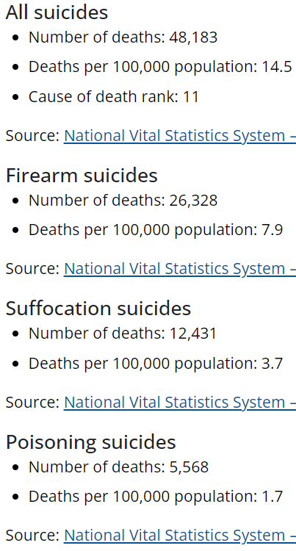
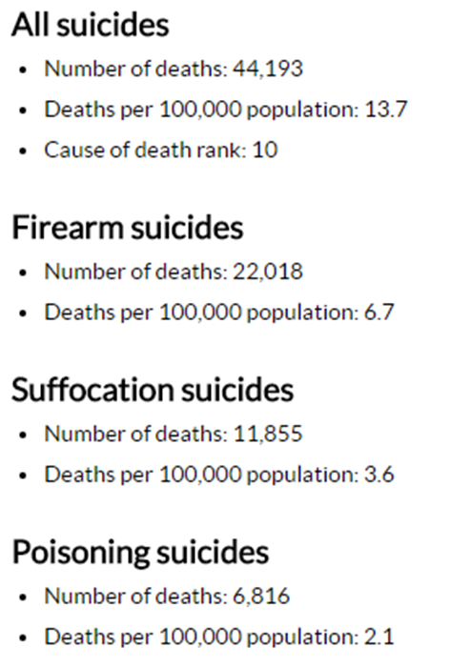
Coroner-Medical Examiner Cases
(from cdc.gov/nchs/fastats)¹¹
2021 (3.4 million total deaths)
2015 (2.7 million total deaths)

Slide 39
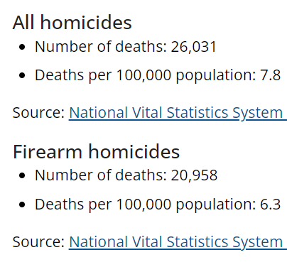
Coroner-Medical Examiner Cases
(from cdc.gov/nchs/fastats)¹¹
2021
2015
42% increase in homicides

Slide 40
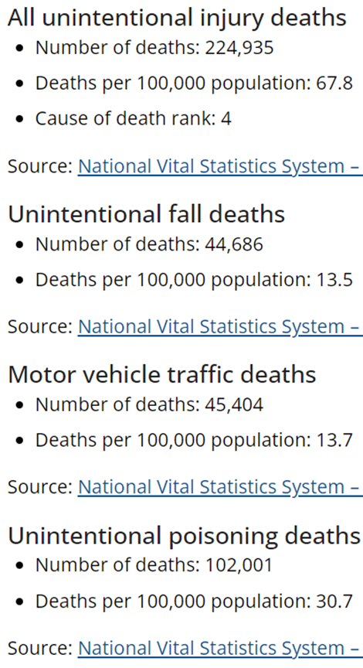
Coroner-Medical Examiner Cases
(from cdc.gov/nchs/fastats)¹¹
2021
2015
107% increase in accidental drug deaths

Slide 41
Coroner-Medical Examiner Cases
State laws require a high number of deaths to be reported to the coroner or ME:
  1.3 million reported deaths in 2018 (2.8 million total deaths); jurisdiction assumed in 605,000 cases⁸
Many are individuals with significant PMHx who die in ERs or outside of hospitals
When the investigation excludes foul play, drug use, and trauma, these deaths are deemed natural
Jurisdiction is waived; PCP is asked to sign the death certificate
Signing the death certificate has benefits:
  Expedites final arrangements
  May reduce financial cost to NOK

Slide 42
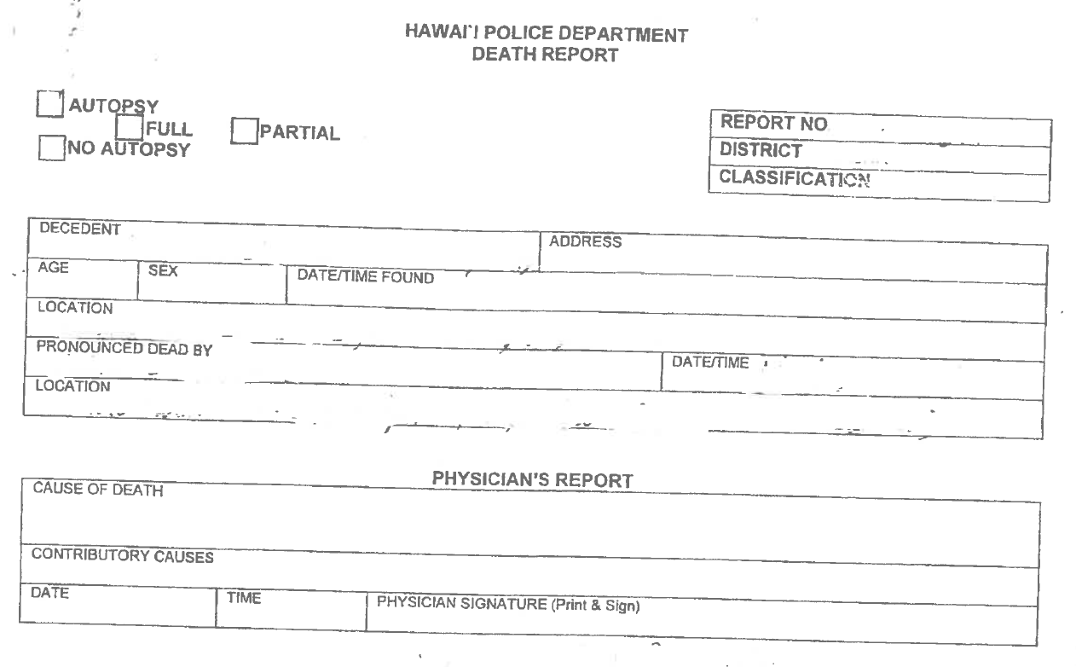
Coroner-Medical Examiner Cases
If death occurred at the scene, body removal services remove the body and transport it Hilo Medical Center for formal death pronouncement by the ER physician
The body is secured in the hospital morgue
HPD death report

Slide 43
Coroner-Medical Examiner Cases
Failure to report Coroner-Medical Examiner cases:
  Usually inadvertent
  Failure to recognize that an injury is the underlying COD
  Compounded by prolonged survival
  Examples:
    Hip fractures and subdural hematomas
    35-year-old man with quadriplegia following an MVA 20 years prior dies of urosepsis due to neurogenic bladder
    75-year-old woman becomes non-ambulatory following a fall and a broken ankle. She dies 2 weeks later from pulmonary emboli due to deep venous thrombosis of the lower extremity caused by her bedridden state
    A 40-year-old man has a witnessed cardiac arrest after using methamphetamine. Resuscitation results in ROSC. Urine drug screen is positive for amphetamines. He is diagnosed with hypoxic-ischemic encephalopathy and dies 1 week later after being placed on comfort care

Slide 44
Introduction to Autopsy
Examination of the body after death:
  External examination of skin and exterior features
  Internal examination of head, neck, and torso organs
Hospital/private autopsy:
  Usually performed by a surgical pathologist
  Natural deaths
  Written consent by legal NOK is required
  May be limited to certain region of the body (i.e. partial autopsy)
  Goals are to confirm diagnoses, determine extent of disease, and assess response to treatment
  Additional benefits include education, training, and research

Slide 45
Introduction to Autopsy
Forensic autopsy:
  Usually performed by a forensic pathologist
  Coroner-Medical Examiner cases
  Coroner and ME have legal authority to perform an autopsy
  Written consent is not required
  Full autopsies are the norm
  Goals are to determine COD and MOD and collect necessary specimens and evidence
Autopsy does not preclude a public viewing at a funeral

Slide 46
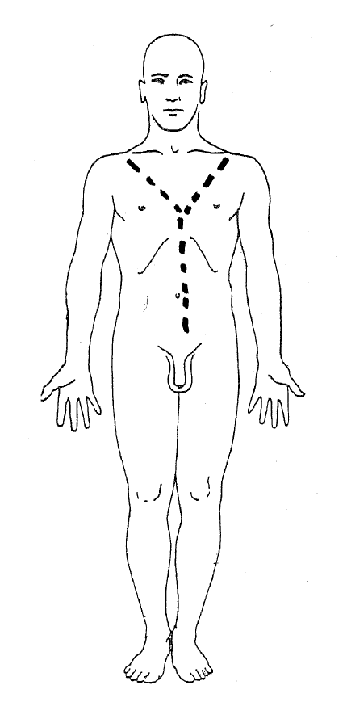
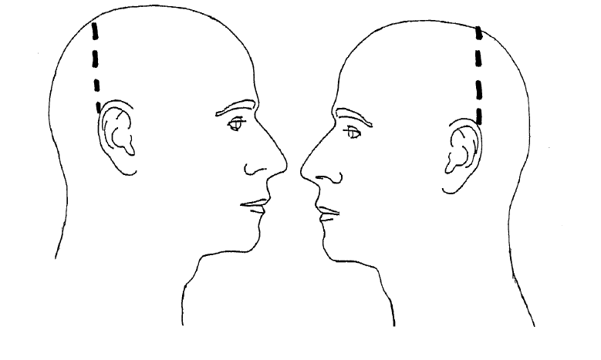
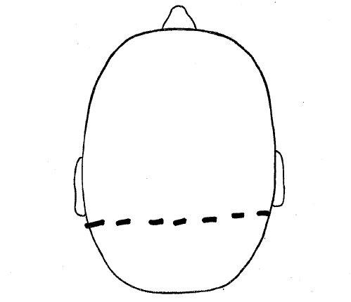
Introduction to Autopsy
Standard autopsy incisions

Slide 47
Introduction to Autopsy
Hospital autopsy process:
  Should not be offered in Coroner-Medical Examiner cases
  Often free of charge at large academic hospitals
  Not always available at smaller hospitals
  Decedent Affairs or Pathology Department is the logistical liaison:
    Help contact NOK and obtain signed consent form
    Distributes autopsy reports:
      Provisional autopsy diagnosis (PAD): most within 1 day
      Final report: most within 30 days
  Discuss special autopsy concerns with the pathologist prior to ordering the autopsy

Slide 48
Take-Home Points
Proper death certification has many benefits to the NOK and the greater community
Cause of death is a medical opinion of the mostly likely reason a person died; 100% certainty is not required
The underlying COD is the initiating illness or injury that results in death
Death certificates must always list an appropriate underlying COD
Cause-of-death statements should follow a pathophysiologic and sequential order
Problematic cause-of-death statements are queried
Unnatural deaths and other deaths defined by state law must be reported to the Coroner or ME; when in doubt…report
While the hospital autopsy and forensic autopsy have different goals, neither affects viewability of the body
Discuss special concerns with the pathologist prior to the autopsy

Slide 49
Pre/Post-Test
When listing a cause of death (COD) on the death certificate, which of the following is/are true?
  The pronouncer of death must also certify the COD
  Listing the underlying COD is sufficient
  An autopsy must be performed prior
  All of the above

Slide 50
Pre/Post-Test
Which of the following is true regarding manner of death (MOD)?
  MOD must be listed on standard death certificates
  MOD is synonymous with COD
  Clinicians can certify any MOD
  None of the above

Slide 51
Pre/Post-Test
Which of the following is an underlying COD?
  Congestive heart failure
  Ventricular fibrillation
  Acute myocardial infarction
  Atherosclerotic coronary artery disease

Slide 52
Pre/Post-Test
Regarding the cause-of-death statement, all of the following are true EXCEPT?
  The immediate COD is listed on the top-most line
  The underlying COD is listed on the bottom-most line
  All four lines must be used
  Listing “Unknown” for the time interval is permitted

Slide 53
Pre/Post-Test
A 65-year-old man is diagnosed with gastric adenocarcinoma. His past medical history includes chronic obstructive pulmonary disease and benign prostatic hypertrophy. He undergoes total gastrectomy. There are no immediate surgical complications. On post-op day 3, he develops hospital-acquired pneumonia. He expires on post-op day 9 from respiratory failure. Which of the following is most appropriate to list on the death certificate under “Other Significant Conditions”?
  Chronic obstructive pulmonary disease
  Hospital-acquired pneumonia
  Benign prostatic hypertrophy
  A and B
  A, B, and C

Slide 54
Pre/Post-Test
A woman presents in her 21st week of pregnancy complaining of decreased fetal movement. An ultrasound confirms intrauterine fetal demise, and a deceased male fetus consistent with 21 weeks gestational age is subsequently delivered. According to Hawaii state law, which of the following is true?
  A death certificate is not required because the fetus was never liveborn
  A death certificate is not required because the fetus was pre-viable
  A death certificate is required because the fetus is at least 20 weeks gestation
  A death certificate is required for all stillbirths

Slide 55
Pre/Post-Test
Which of the following if listed on the death certificate will trigger an inquiry by the health department?
  Hypersensitivity pneumonitis
  Metastatic malignancy of unknown primary
  Quadriplegia
  Huntington’s Disease

Slide 56
Pre/Post-Test
All of the following should be reported to the coroner EXCEPT?
  An inmate death in a prison infirmary
  A death due to complications of chronic alcohol abuse
  A death following intentional acute drug overdose
  An apparent SIDS death

Slide 57
Pre/Post-Test
Your patient is a 72-year-old man with coronary artery disease, ischemic cardiomyopathy, hypertension, CHF, and morbid obesity. He was witnessed by family to suddenly become unresponsive at home. EMS found him in ventricular fibrillation. Resuscitation efforts at the scene were unsuccessful. You last saw the decedent at clinic 2 weeks ago, at which time he voiced no unusual complaints. The coroner reports to you that there is no foul play, trauma, or evidence of drug use. You should:
  Not sign the death certificate because he died outside of the hospital
  Not sign the death certificate because an autopsy has not yet been performed
  Not sign the death certificate because the COD is unknown
  Sign the death certificate because the death appears natural

Slide 58
Pre/Post-Test
An inpatient on your service dies. The family requests an autopsy. You tell them:
  Written consent from the appropriate next of kin is required for a hospital autopsy
  A hospital autopsy is only indicated when the COD is uncertain
  A hospital autopsy should be performed prior to a forensic autopsy since the patient died in the hospital
  A potential drawback of an autopsy is disfigurement of the body

Slide 59
Resources
Cause-of-death statements and death certificates:
  https://www.cdc.gov/nchs/data/dvs/blue_form.pdf
  https://www.cdc.gov/nchs/training/improving-cause-of-death-reporting/course.htm
Hawaii state laws regarding death certificates:
  https://www.capitol.hawaii.gov/hrscurrent/vol06_ch0321-0344/HRS0338/HRS_0338-.htm
Hawaii state laws regarding Coroner-ME cases:
  https://www.capitol.hawaii.gov/hrscurrent/vol14_ch0701-0853/HRS0841/HRS_0841-0014.htm
Reporting Coroner-Medical Examiner cases:
  Big Island: Hawaii Police Department (808) 935-3311
  Oahu: Honolulu Medical Examiner (808) 768-3090
  Maui: Maui Police Department (808) 244-6400
  Kauai: Kauai Police Department (808) 241-1711
Brian Nagao: brian.nagao@hawaiilabs.com

Slide 60
References
1. HRS Chapter 338: Vital Statistics. https://www.capitol.hawaii.gov/hrscurrent/vol06_ch0321-0344/HRS0338/HRS_0338-.htm
2. Sejbuk NE, Friedman E, Lieb L. Creating an Accurate Cause of Death Statement on a Death Certificate. Rx for Prevention. May 2014.
3. Alipour J, Payandeh A. Common errors in reporting cause-of-death statement on death certificates: A systematic review and meta-analysis. J Forensic Leg Med. 2021 Aug;82:102220.
4. McGivern L, Shulman L, Carney JK, Shapiro S, Bundock E. Death Certification Errors and the Effect on Mortality Statistics. Public Health Rep. 2017;132(6):669–75.
5. Wykowski JH, Luks AM, Berger G, Marshall DA. Death Certification: An Interactive Teaching Session. MedEdPORTAL. 2023 Jan 17;19:11296.
6. Lakkireddy DR, Basarakodu KR, Vacek JL, Kondur AK, Ramachandruni SK, Esterbrooks DJ, Markert RJ, Gowda MS. Improving death certificate completion: a trial of two training interventions. J Gen Intern Med. 2007 Apr;22(4):544-8.
7. State Medical Examiners and Coroners Organizations. https://www.cdc.gov/nchs/comec/state-mec-organizations.html#print
8. Medical Examiner and Coroner Offices, 2018. U.S. Department of Justice November 2021.
9. HRS Chapter 841: Coroner Inquests. https://www.capitol.hawaii.gov/hrscurrent/vol14_ch0701-0853/HRS0841/HRS_0841-0014.htm
10. Prahlow, J. Basic Competencies in Forensic Pathology. College of American Pathologists. Northfield, IL, 2006.
11. National Center for Health Statistics. https://www.cdc.gov/nchs/fastats/

